Slide 1



LUIS MAÑEZ
My
Profile Awards WebPart
Using the Beta MS Graph Profile endpoint
#SharePoint Framework community call 30th of June 2022

Slide 2
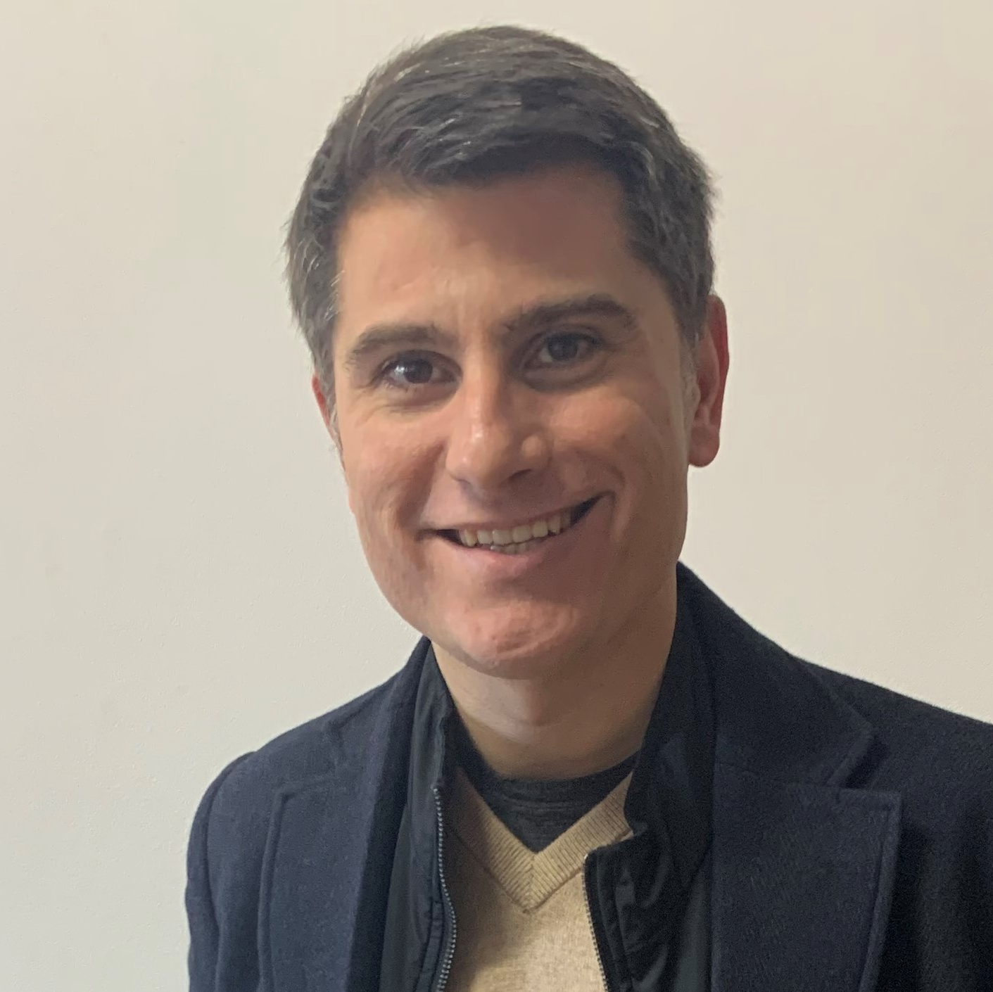




About Me
LUIS MAÑEZ
Luis Mañez
Chief Architect @ ClearPeople
Office Development MVP. More than 20 years of experience working with Microsoft Technologies. MS Certified specialist in Developing Azure and SharePoint MCPD. Passionate about technology, blogger, technical writer and MS community active member.
@luismanez
#SharePoint Framework community call 30th of June 2022

Slide 3
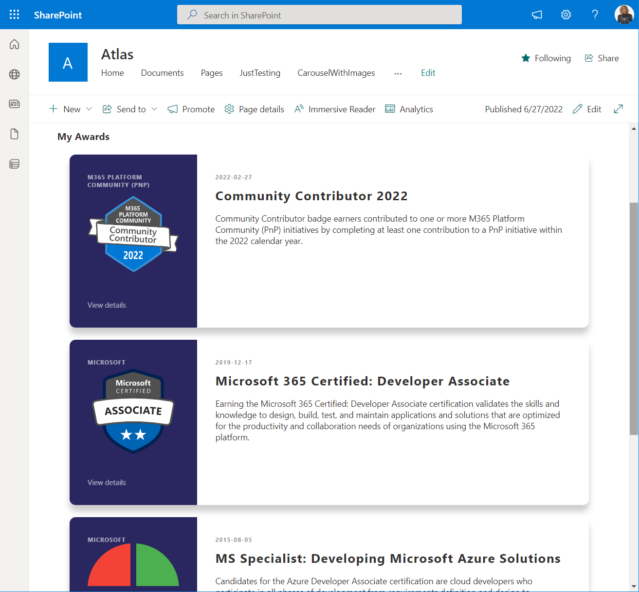
See it in action
LUIS MAÑEZ
#SharePoint Framework community call 30th of June 2022

Slide 4
MS Graph API Beta Profile Endpoint
LUIS MAÑEZ
Profile
Account Information
Addresses
Anniversaries
Awards
Certifications
Educational Activity
Email Address
Interests
Languages
Names
Notes
Patents
Phones
Positions
Projects
Publications
Responsibilities
Skills
Web Accounts
Websites
https://docs.microsoft.com/en-us/graph/api/resources/profile?view=graph-rest-beta
#SharePoint Framework community call 30th of June 2022

Slide 5
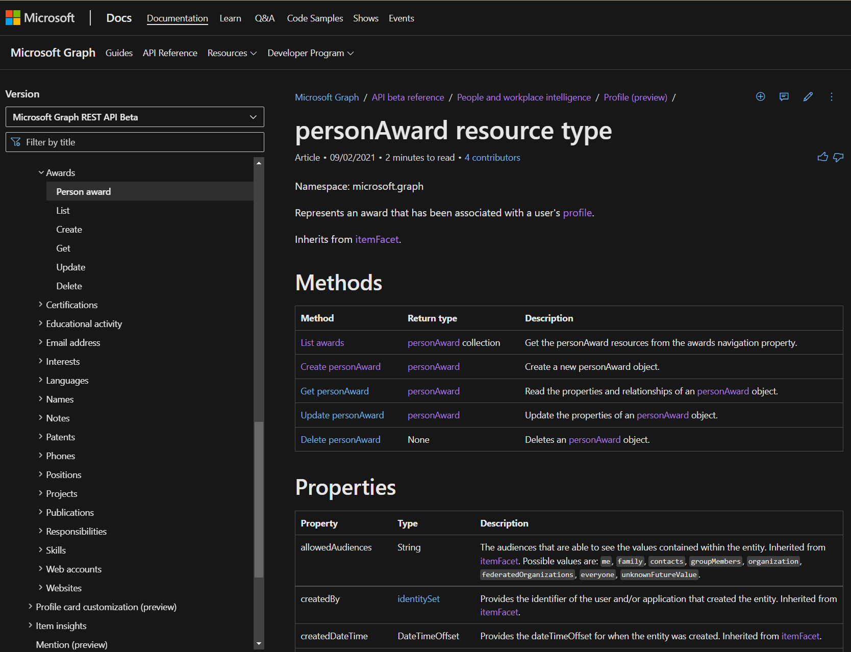
Awards
LUIS MAÑEZ
#SharePoint Framework community call 30th of June 2022

Slide 6
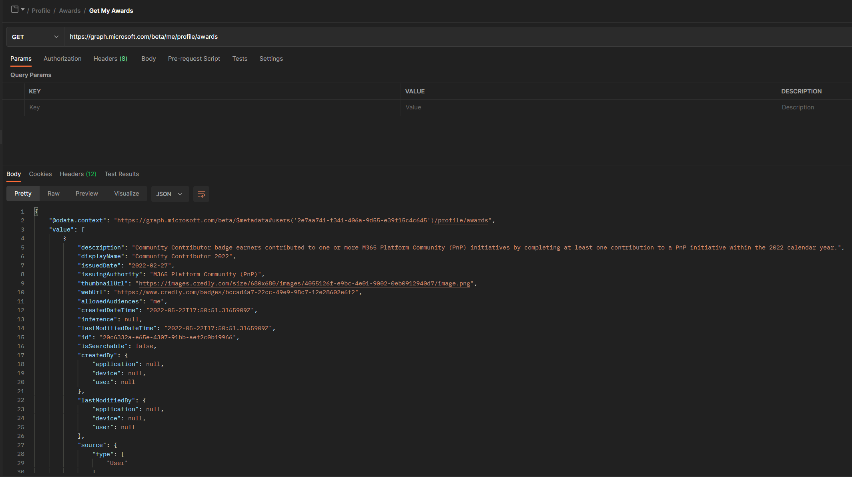
LUIS MAÑEZ
#SharePoint Framework community call 30th of June 2022

Slide 7
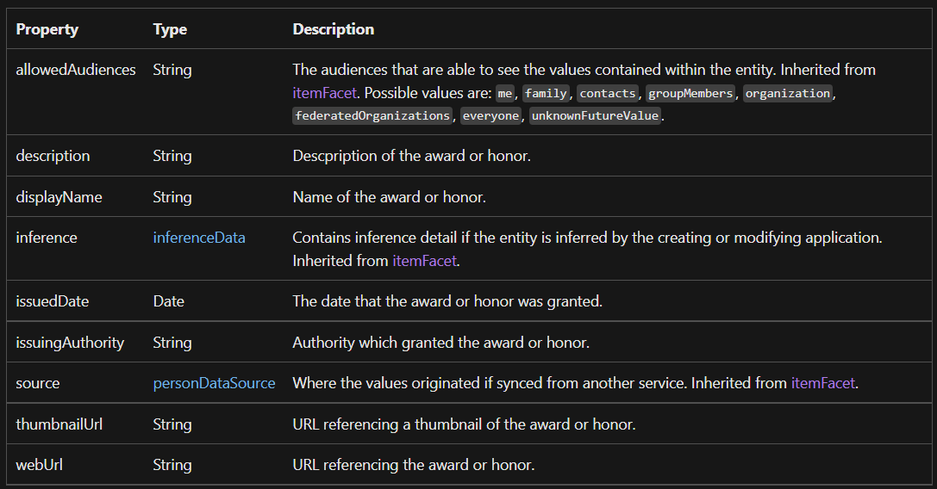
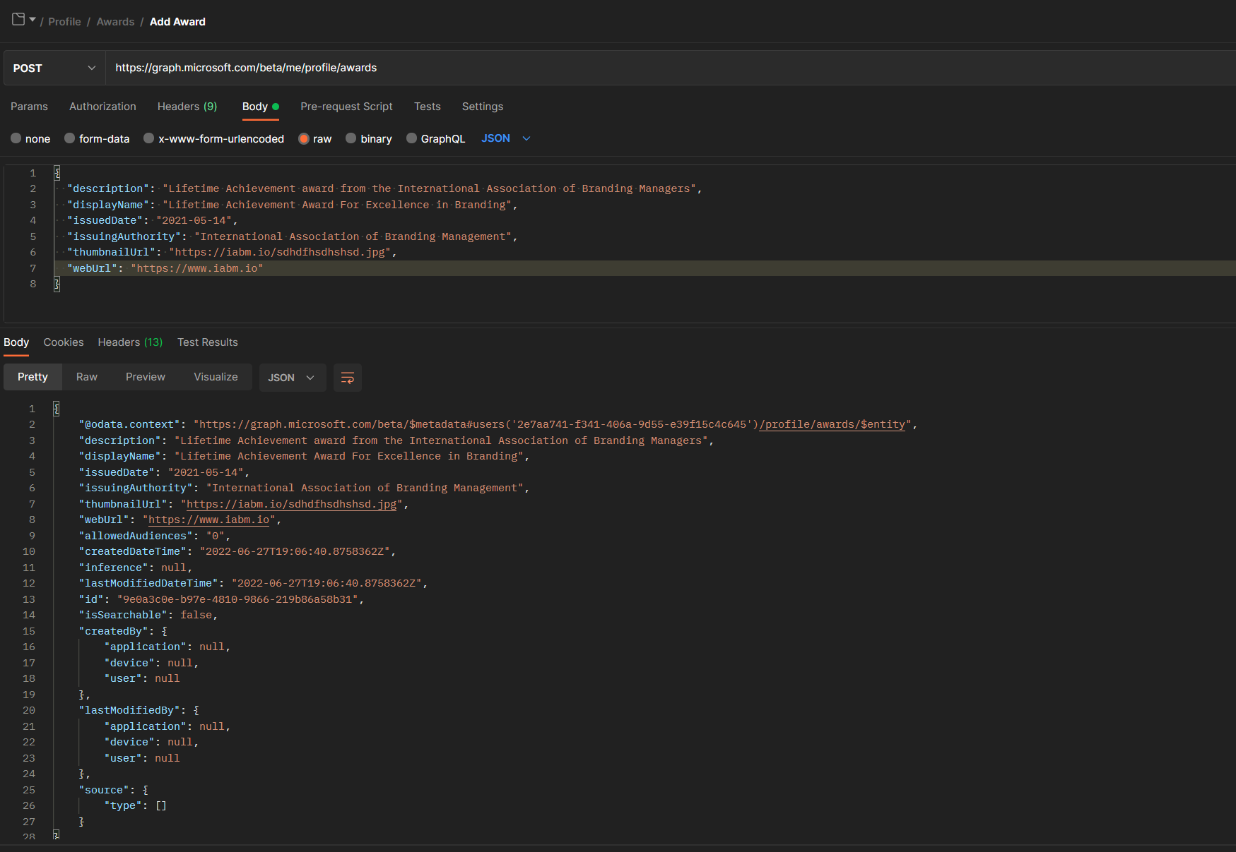
LUIS MAÑEZ
#SharePoint Framework community call 30th of June 2022

Slide 8

Let´s dive in!

Slide 9
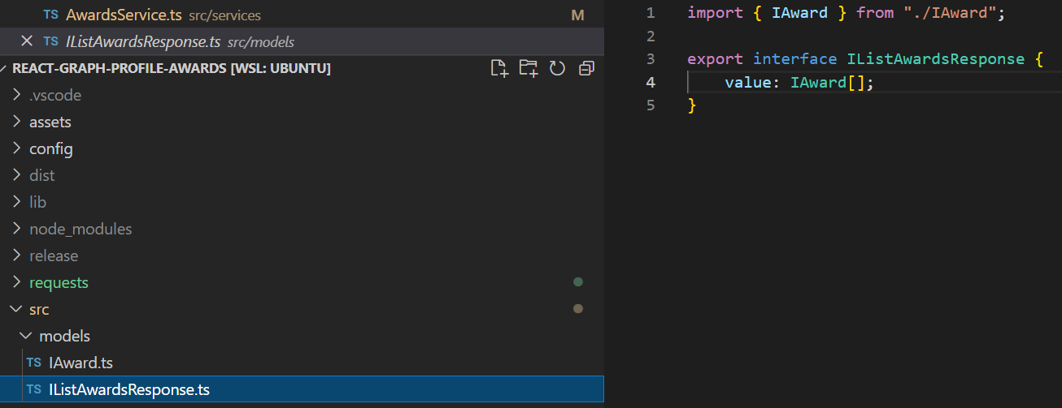
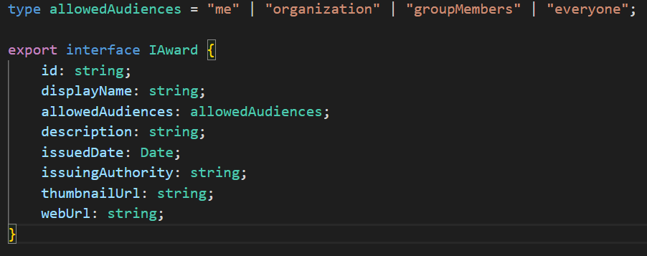
LUIS MAÑEZ
#SharePoint Framework community call 30th of June 2022

Slide 10
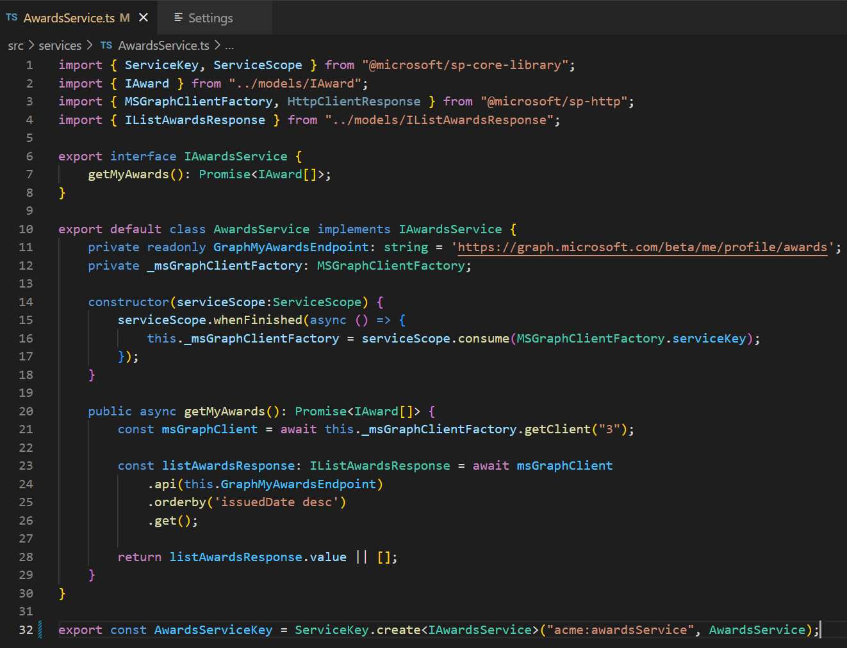
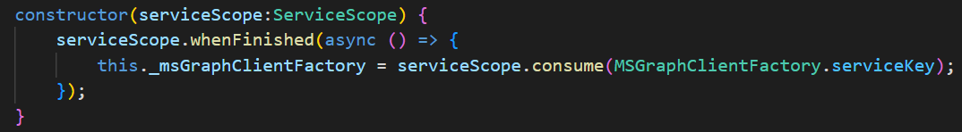
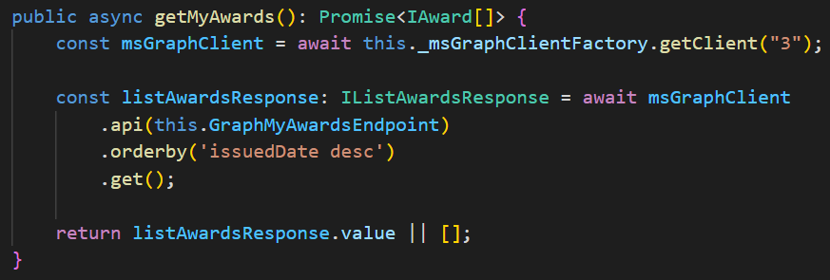
LUIS MAÑEZ
#SharePoint Framework community call 30th of June 2022

Slide 11
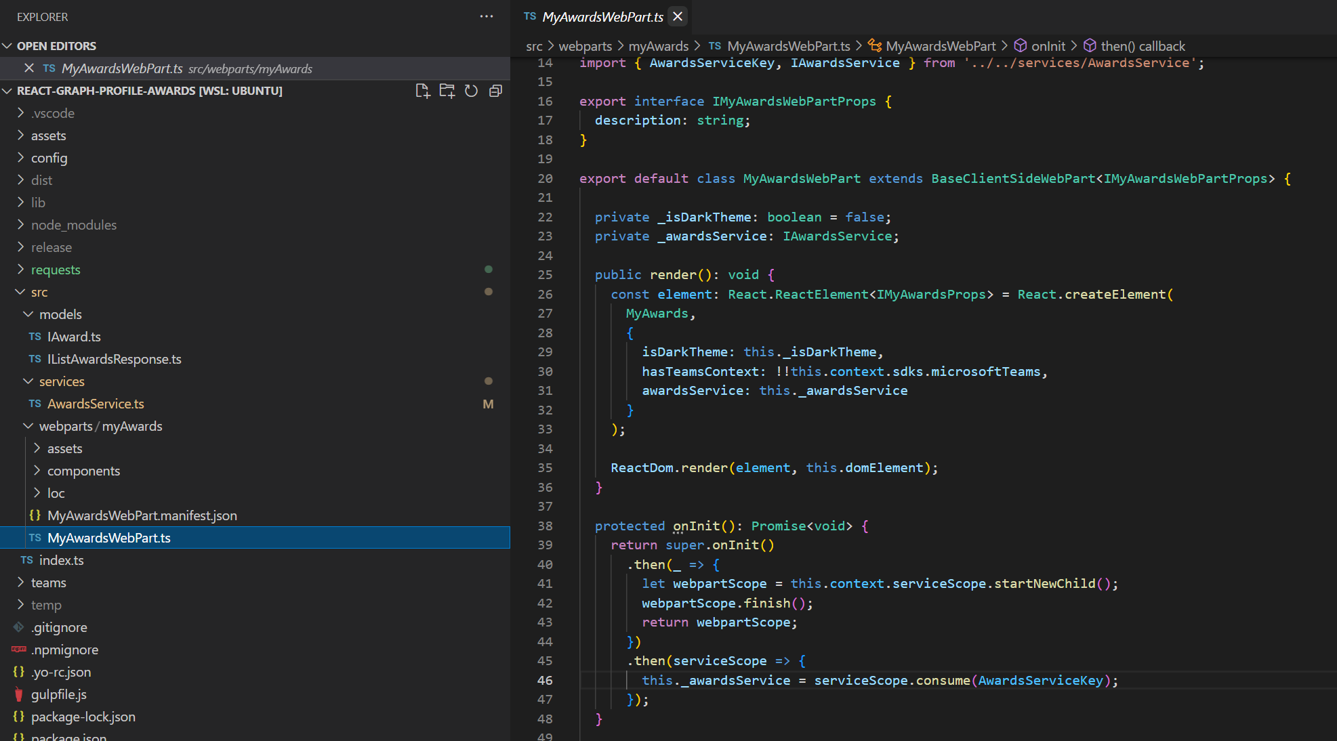
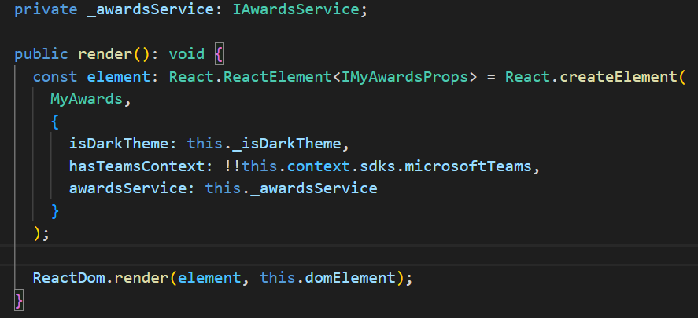
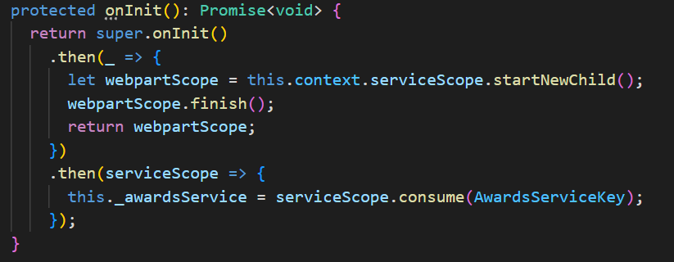
LUIS MAÑEZ
#SharePoint Framework community call 30th of June 2022

Slide 12
LUIS MAÑEZ
https://github.com/pnp/sp-dev-fx-webparts/tree/main/samples/react-graph-profile-awards
#SharePoint Framework community call 30th of June 2022

Slide 13



LUIS MAÑEZ
Thanks!
#sharingiscaring
@luismanez
#SharePoint Framework community call 30th of June 2022
Notes:
Display resolution to 1080
Thanks and intro about the webpart
About me
See it in action
About Graph profile endpoint
Add/Get Award using Postman
Source code

